Slide 1
Boutique Inventory & Warehouse Management API
Explanation of the final solution + code
C# / ASP.NET Core Web API
SQL Server + Stored Procedures
Swagger + Postman
Dashboard UI
Boutique Inventory & Warehouse Management API
In simple words
• The project is like a digital notebook for a boutique owner.
• It remembers every product, where it is stored, what category it belongs to, and when it expires.
• The API is the middle helper that talks between the web page, Swagger/Postman, and the SQL Server database.
Boutique Inventory API
01

Slide 2
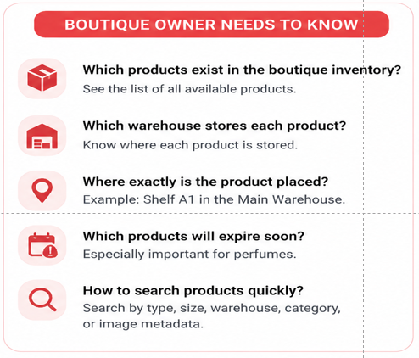
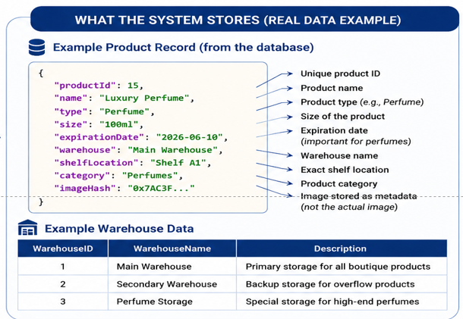
1. The Business Problem
Why this system is needed
Boutique Inventory & Warehouse Management API
Boutique Inventory API
02

Slide 3
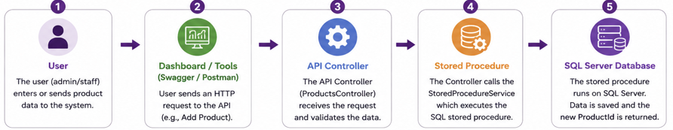
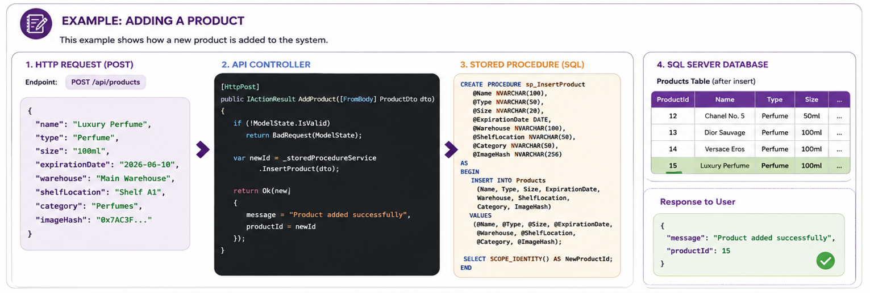
2. How the System Works
The complete request journey
Example: adding a product
Boutique Inventory & Warehouse Management API
• The user sends product data. The ProductsController receives it. The StoredProcedureService calls sp_InsertProduct. SQL Server saves the product and returns the new ProductId.
03
Boutique Inventory API

Slide 4
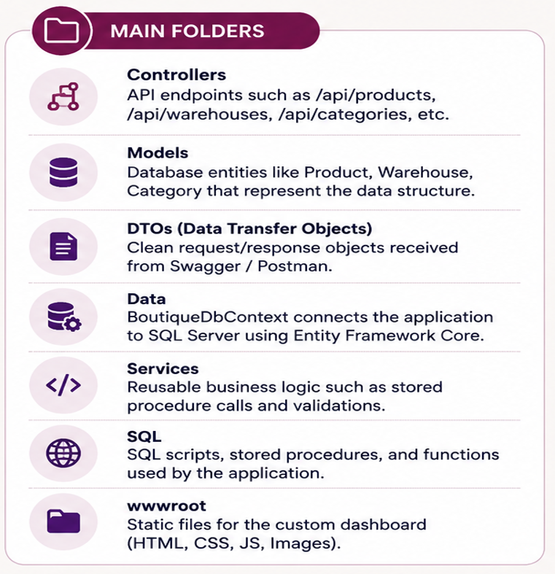
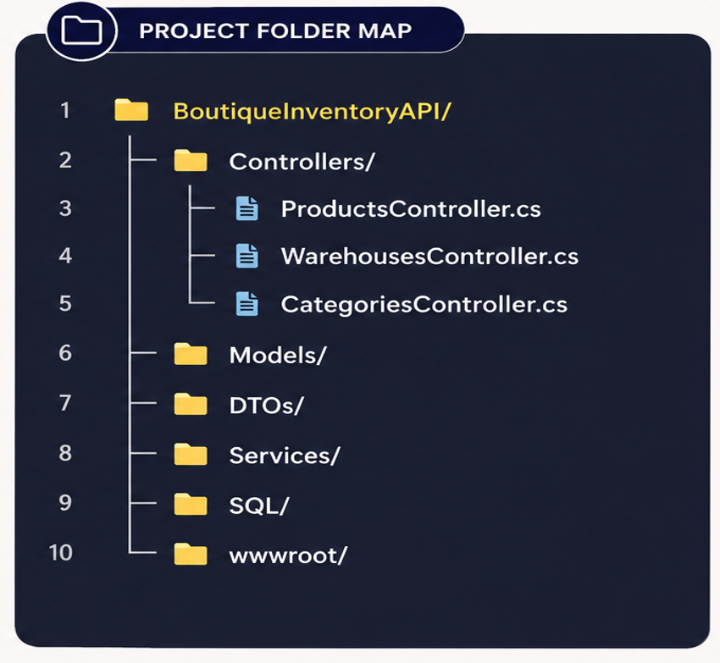
3. Project Structure
What each folder is responsible for
Boutique Inventory & Warehouse Management API
Boutique Inventory API
04

Slide 5
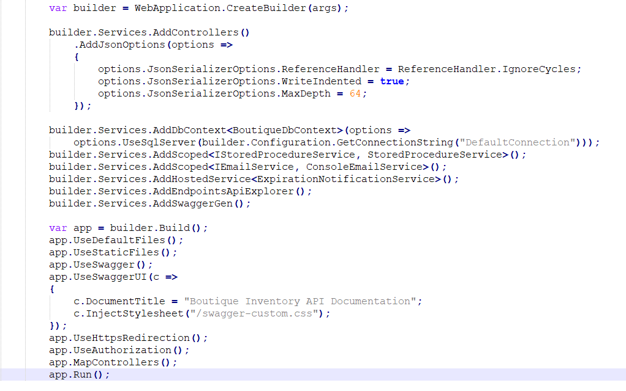
4. Program.cs — Starting the API
This file wires the whole project together
What this code means
• AddControllers enables API controllers.
• IgnoreCycles prevents JSON loops such as
Product → Warehouse → Products.
• UseSqlServer connects the API to SQL Server using appsettings.json.
• Services are registered so controllers can use them.
• Swagger and static dashboard files are enabled.
Boutique Inventory & Warehouse Management API
Boutique Inventory API
05

Slide 6
5. Product Model — What a Product Contains
The Product class becomes the Products table in SQL Server
Fields explained simply
Models/Product.cs
• Name: product name, for example Luxury Perfume
• Type and Size: basic product attributes
• ExpirationDate: used for expiring-soon alerts
• ImagePath: stores image metadata or image file path
• WarehouseId: tells which warehouse owns the product
• ShelfLocation: tells where inside the warehouse it is stored
1 public class Product
2 {
3 public int Id { get; set; }
4 public string Name { get; set; } = string.Empty;
5 public string Type { get; set; } = string.Empty;
6 public string? Size { get; set; }
7 public DateTime? ExpirationDate { get; set; }
8 public string? ImagePath { get; set; }
9
10 public int WarehouseId { get; set; }
11 public Warehouse? Warehouse { get; set; }
12
13 public string ShelfLocation { get; set; } = string.Empty;
14 public List<ProductCategory> ProductCategories { get; set; } = new();
15 }
Boutique Inventory & Warehouse Management API
Boutique Inventory API
06

Slide 7
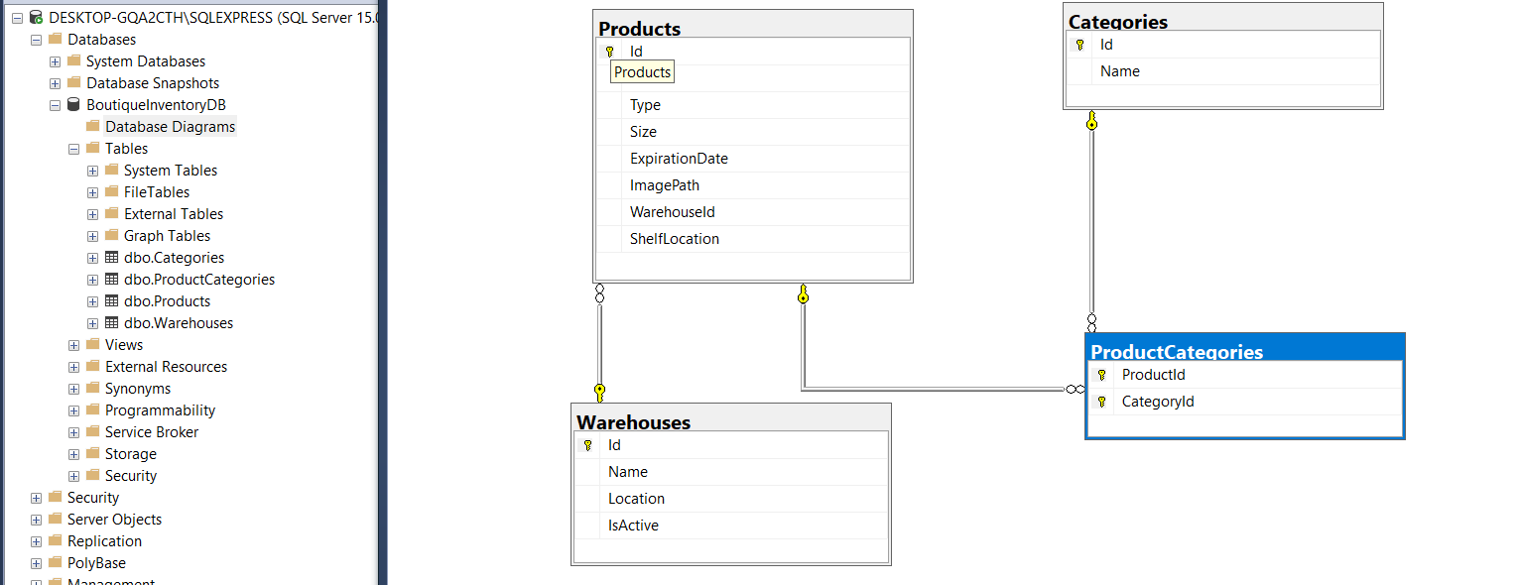
6. Database Relationships
How products, categories, and warehouses connect
Relationship logic
Data/BoutiqueDbContext.cs
• One warehouse can contain many products.
• One product can have multiple categories.
• One category can be assigned to many products.
• ProductCategories is the middle table for product-category links.
• This is important because one item may be both Perfume and Gift Set.
1 modelBuilder.Entity<ProductCategory>()
2 .HasKey(pc => new { pc.ProductId, pc.CategoryId });
3
4 modelBuilder.Entity<ProductCategory>()
5 .HasOne(pc => pc.Product)
6 .WithMany(p => p.ProductCategories)
7 .HasForeignKey(pc => pc.ProductId);
8
9 modelBuilder.Entity<ProductCategory>()
10 .HasOne(pc => pc.Category)
11 .WithMany(c => c.ProductCategories)
12 .HasForeignKey(pc => pc.CategoryId);
Boutique Inventory & Warehouse Management API
Boutique Inventory API
07

Slide 8
7. SQL Server Script
The database is created using SQL tables and Stored Procedures
Why SQL script matters
SQL/01_CreateTables_And_StoredProcedures.sql
• It creates the database tables.
• It defines foreign keys, so invalid warehouse links are prevented.
• It creates Stored Procedures for insert and update.
• It inserts starter sample data for testing.
1 CREATE TABLE dbo.Products(
2 Id INT IDENTITY(1,1) PRIMARY KEY,
3 Name NVARCHAR(100) NOT NULL,
4 Type NVARCHAR(100) NOT NULL,
5 Size NVARCHAR(50) NULL,
6 ExpirationDate DATETIME2 NULL,
7 ImagePath NVARCHAR(300) NULL,
8 WarehouseId INT NOT NULL,
9 ShelfLocation NVARCHAR(100) NOT NULL,
10 CONSTRAINT FK_Products_Warehouses
11 FOREIGN KEY(WarehouseId)
12 REFERENCES dbo.Warehouses(Id)
13 );
Boutique Inventory & Warehouse Management API
Boutique Inventory API
08

Slide 9
8. Stored Procedure: Insert Product
This is where SQL Server saves a new product
What happens here
Stored Procedure snippet
1 CREATE OR ALTER PROCEDURE dbo.sp_InsertProduct
2 @Name NVARCHAR(100),
3 @Type NVARCHAR(100),
4 @WarehouseId INT,
5 @CategoryIds NVARCHAR(MAX)=NULL,
6 @NewId INT OUTPUT
7 AS
8 BEGIN
9 IF NOT EXISTS(
10 SELECT 1 FROM dbo.Warehouses
11 WHERE Id=@WarehouseId AND IsActive=1)
12 BEGIN
13 RAISERROR('Warehouse does not exist or is inactive.',16,1);
14 RETURN;
15 END
16
17 INSERT INTO dbo.Products(Name,Type,WarehouseId,ShelfLocation)
18 VALUES(@Name,@Type,@WarehouseId,@ShelfLocation);
19
20 SET @NewId = SCOPE_IDENTITY();
21 END
• The procedure first checks if the selected warehouse exists and is active.
• Then it inserts the product into Products.
• SCOPE_IDENTITY() returns the new ProductId.
• Category IDs are split from a comma-separated list and inserted into ProductCategories.
Boutique Inventory & Warehouse Management API
Boutique Inventory API
09

Slide 10
9. C# Service Calls the sql Stored Procedure
The API does not insert directly; it calls SQL Server SPs
Why this is a good design
Services/StoredProcedureService.cs
1 public async Task<int> InsertProductAsync(ProductCreateDto dto)
2 {
3 var newId = new SqlParameter("@NewId", SqlDbType.Int)
4 {
5 Direction = ParameterDirection.Output
6 };
7
8 var categoryIds = string.Join(",", dto.CategoryIds.Distinct());
9
10 await _context.Database.ExecuteSqlRawAsync(
11 "EXEC dbo.sp_InsertProduct @Name, @Type, @Size, " +
12 "@ExpirationDate, @ImagePath, @WarehouseId, " +
13 "@ShelfLocation, @CategoryIds, @NewId OUTPUT",
14 new SqlParameter("@Name", dto.Name),
15 new SqlParameter("@WarehouseId", dto.WarehouseId),
16 newId);
17
18 return (int)newId.Value;
19 }
• Controllers stay cleaner because SQL execution is inside a service.
• Parameters are passed safely using SqlParameter.
• The database returns the new ID through an output parameter.
• The same service can be reused by different controllers later.
Boutique Inventory & Warehouse Management API
Boutique Inventory API
10

Slide 11
10. ProductsController: Create and Update
The controller receives requests from Swagger, Postman, or the dashboard
Controllers/ProductsController.cs
Simple explanation
1 [HttpPost]
2 public async Task<IActionResult> Create(ProductCreateDto dto)
3 {
4 var id = await _spService.InsertProductAsync(dto);
5
6 return CreatedAtAction(nameof(GetById), new { id }, new
7 {
8 message = "Product created successfully.",
9 productId = id
10 });
11 }
12
13 [HttpPut("{id}")]
14 public async Task<IActionResult> Update(int id, ProductUpdateDto dto)
15 {
16 await _spService.UpdateProductAsync(id, dto);
17 return Ok(new { message = "Product updated successfully.", productId = id });
18 }
• POST /api/products creates a new product.
• PUT /api/products/{id} updates an existing product.
• The controller does not directly write SQL.
• It sends the DTO to StoredProcedureService, which calls the Stored Procedure.
Boutique Inventory & Warehouse Management API
Boutique Inventory API
11

Slide 12
11. Reading Products Safely
The GetAll endpoint returns clean data without JSON cycles
Why the projection is important
GET /api/products
1 [HttpGet]
2 public async Task<IActionResult> GetAll(int page = 1, int pageSize = 10)
3 {
4 var query = _context.Products
5 .Include(p => p.Warehouse)
6 .AsQueryable();
7
8 var total = await query.CountAsync();
9
10 var products = await query
11 .OrderBy(p => p.Name)
12 .Skip((page - 1) * pageSize)
13 .Take(pageSize)
14 .Select(p => new {
15 p.Id, p.Name, p.Type, p.Size,
16 WarehouseName = p.Warehouse != null ? p.Warehouse.Name : null,
17 p.ShelfLocation
18 })
19 .ToListAsync();
20
21 return Ok(new { total, page, pageSize, products });
22 }
• Earlier, returning full Product objects can cause an object cycle.
• Example cycle:
Product → Warehouse → Products → Warehouse.
• The fixed version selects only the fields needed for the response.
• This gives a cleaner JSON result for Swagger, Postman, and the dashboard.
Boutique Inventory & Warehouse Management API
Boutique Inventory API
12

Slide 13
12. Search & Filtering
The owner can quickly find products
Search examples
Search endpoint logic
1 [HttpGet("search")]
2 public async Task<IActionResult> Search(
3 string? name, string? type, string? size,
4 int? categoryId, int? warehouseId,
5 string? shelfLocation, string? imagePath)
6 {
7 var query = _context.Products
8 .Include(p => p.Warehouse)
9 .Include(p => p.ProductCategories)
10 .ThenInclude(pc => pc.Category)
11 .AsQueryable();
12
13 if (!string.IsNullOrWhiteSpace(type))
14 query = query.Where(p => p.Type == type);
15
16 if (categoryId.HasValue)
17 query = query.Where(p =>
18 p.ProductCategories.Any(pc => pc.CategoryId == categoryId.Value));
19
20 return Ok(await query.ToListAsync());
21 }
• Find all perfumes: /api/products/search?type=Perfume
• Find products in warehouse 1: ?warehouseId=1
• Find size M clothes: ?type=Clothes&size=M
• Find image metadata: ?imagePath=perfume1
• Find category: ?categoryId=1
Boutique Inventory & Warehouse Management API
Boutique Inventory API
13

Slide 14
13. Expiration Monitoring
The system warns about products that expire soon
How it works
GET /api/products/expiring-soon
1 [HttpGet("expiring-soon")]
2 public async Task<IActionResult> ExpiringSoon()
3 {
4 var today = DateTime.Today;
5 var limitDate = today.AddMonths(1);
6
7 var products = await _context.Products
8 .Include(p => p.Warehouse)
9 .Where(p =>
10 p.ExpirationDate != null &&
11 p.ExpirationDate >= today &&
12 p.ExpirationDate <= limitDate)
13 .OrderBy(p => p.ExpirationDate)
14 .ToListAsync();
15
16 return Ok(products);
17 }
• The API calculates today's date and one month from today.
• Products with ExpirationDate inside that window are selected.
• The background service checks this automatically.
• The ConsoleEmailService simulates sending a warning email.
Boutique Inventory & Warehouse Management API
Boutique Inventory API
14

Slide 15
14. Dashboard UI
A friendlier page for public presentation
What the dashboard does
wwwroot/app.js
1 async function loadProducts() {
2 const response = await fetch("/api/products");
3 const data = await response.json();
4
5 const products = data.products || data;
6 document.getElementById("totalProducts")
7 .innerText = data.total || products.length;
8
9 products.forEach(p => {
10 table.innerHTML += `
11 <tr>
12 <td>${p.name}</td>
13 <td>${p.type}</td>
14 <td>${p.warehouseName ?? ""}</td>
15 </tr>`;
16 });
17 }
• Shows total products, warehouses, categories, and expiring products.
• Displays products in a simple table.
• Allows adding warehouses and categories without using Swagger.
• Uses fetch() to call the same API endpoints.
Boutique Inventory & Warehouse Management API
Boutique Inventory API
15

Slide 16
14. How to Use and Test the API
Step-by-step for the final demo
Demo steps
Run + test checklist
1 dotnet restore
2 dotnet run
3
4 # Browser
5 https://localhost:5001
6 https://localhost:5001/swagger
7
8 # Example request
9 POST /api/products
10
11 {
12 "name": "Luxury Perfume",
13 "type": "Perfume",
14 "size": "100ml",
15 "warehouseId": 1,
16 "shelfLocation": "Shelf A1",
17 "categoryIds": [1]
18 }
1. Start SQL Server and run the SQL script.
2. Check appsettings.json connection string.
3. Run the project using
dotnet clean
dotnet build
dotnet run
4. Open dashboard: https://localhost:5001
5. Open Swagger: https://localhost:5001/swagger
6. Test POST /api/products and GET /api/products/search.
Boutique Inventory & Warehouse Management API
Boutique Inventory API
16

Slide 17
Final Summary
What this project demonstrates
Implemented requirements
Possible future upgrades
• Multiple warehouses can be created, updated, deleted, and deactivated.
• Products are stored with type, size, image path, expiration date, warehouse, and shelf location.
• Categories are custom-defined and products can have multiple categories.
• Search, pagination, expiration monitoring, Swagger, Postman, and dashboard UI are included.
• Real email sending using SMTP instead of console simulation.
• Authentication and user roles for secure access.
• Real image upload and image similarity search.
• Mobile application consuming the same centralized API.
Boutique Inventory & Warehouse Management API
Boutique Inventory API
17

